Slide 1
LasPay Card Management System
Business & Operations Briefing for Senior Management
Prepared by Karsaaz — CMS Delivery Team | August 2026 | Confidential
Notes:
Good morning / afternoon. Thank you for the time today. This session gives senior management a business-level walkthrough of the LasPay Card Management System — what it does, how it protects the bank and the customer, and how the day-to-day card lifecycle actually works on screen. Each flow slide today also lists its key underlying APIs at a glance, with the full technical contract documented separately for engineering and integration teams.

Slide 2
AGENDA
What We'll Cover Today
The business case: what CMS does and why it matters
How the platform is organised and secured
The card lifecycle, step by step — with live screens and key APIs
Dashboard KPIs, compliance controls, and next steps
LasPay Card Management System | Confidential
2 / 27
Notes:
Quick roadmap for the session. We'll start with the business value and platform structure, then walk through the actual screens for the full card lifecycle — request, approval, generation, and ongoing operations — with the key API for each step shown alongside, and close with the security model and what's next. Questions are welcome throughout, but we'll also leave time at the end.

Slide 3
EXECUTIVE SUMMARY
A Secure, Controlled Platform for the Full Card Lifecycle
One system for card production, day-to-day operations, and housekeeping — replacing manual, fragmented processes
Every card request passes through independent maker/checker approval before it is generated
Role-based access means each user only sees the screens and actions relevant to their job
Built-in dashboard gives operations leadership a real-time view of pending work and risk
LasPay Card Management System | Confidential
3 / 27
Notes:
At the highest level, LasPay CMS gives us one controlled system for managing cards from request through to expiry and replacement — instead of relying on spreadsheets, email approvals, or disconnected tools. The two things I want you to hold onto through this deck are dual control — no single person can both request and approve a card — and visibility, through the dashboard and audit trail. Both are core to satisfying our compliance and risk requirements.

Slide 4
BUSINESS VALUE
Key Capabilities & Business Value
Card production — controlled issuance with maker/checker approval before any card is generated
Operations — search, status changes, replacements, and type changes for the full card book
Housekeeping — central configuration of products, card types, limits, and branches
Security & Dashboard — role-based access, encrypted sessions, and real-time operational KPIs
LasPay Card Management System | Confidential
4 / 27
Notes:
This slide maps our five capability areas straight to business value. Card production is where dual control lives. Operations is the day-to-day work — most of the user base will live here. Housekeeping is how we keep product and limit data centrally governed rather than hard-coded. And security plus the dashboard are what give management and audit the confidence that the system is being used correctly.

Slide 5
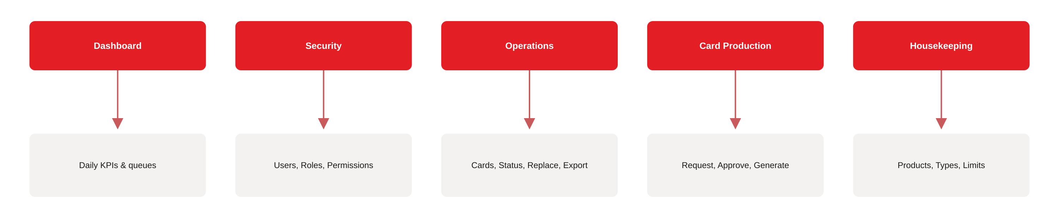
PLATFORM
Five Functional Areas, One Platform
Dashboard — daily KPIs and operational queues
Security — users, roles, and permissions
Operations — card status, replacement, export
Card Production & Housekeeping — request, approve, generate, configure
LasPay Card Management System | Confidential
5 / 27
Notes:
The platform is organised into five functional areas, all reachable from the same navigation menu. Dashboard gives leadership visibility. Security governs who can do what. Operations is where card operators do day-to-day work. Card Production and Housekeeping together form the controlled pipeline for issuing new cards and maintaining the reference data behind them. This modular structure is what lets us scale the user base without losing control.

Slide 6
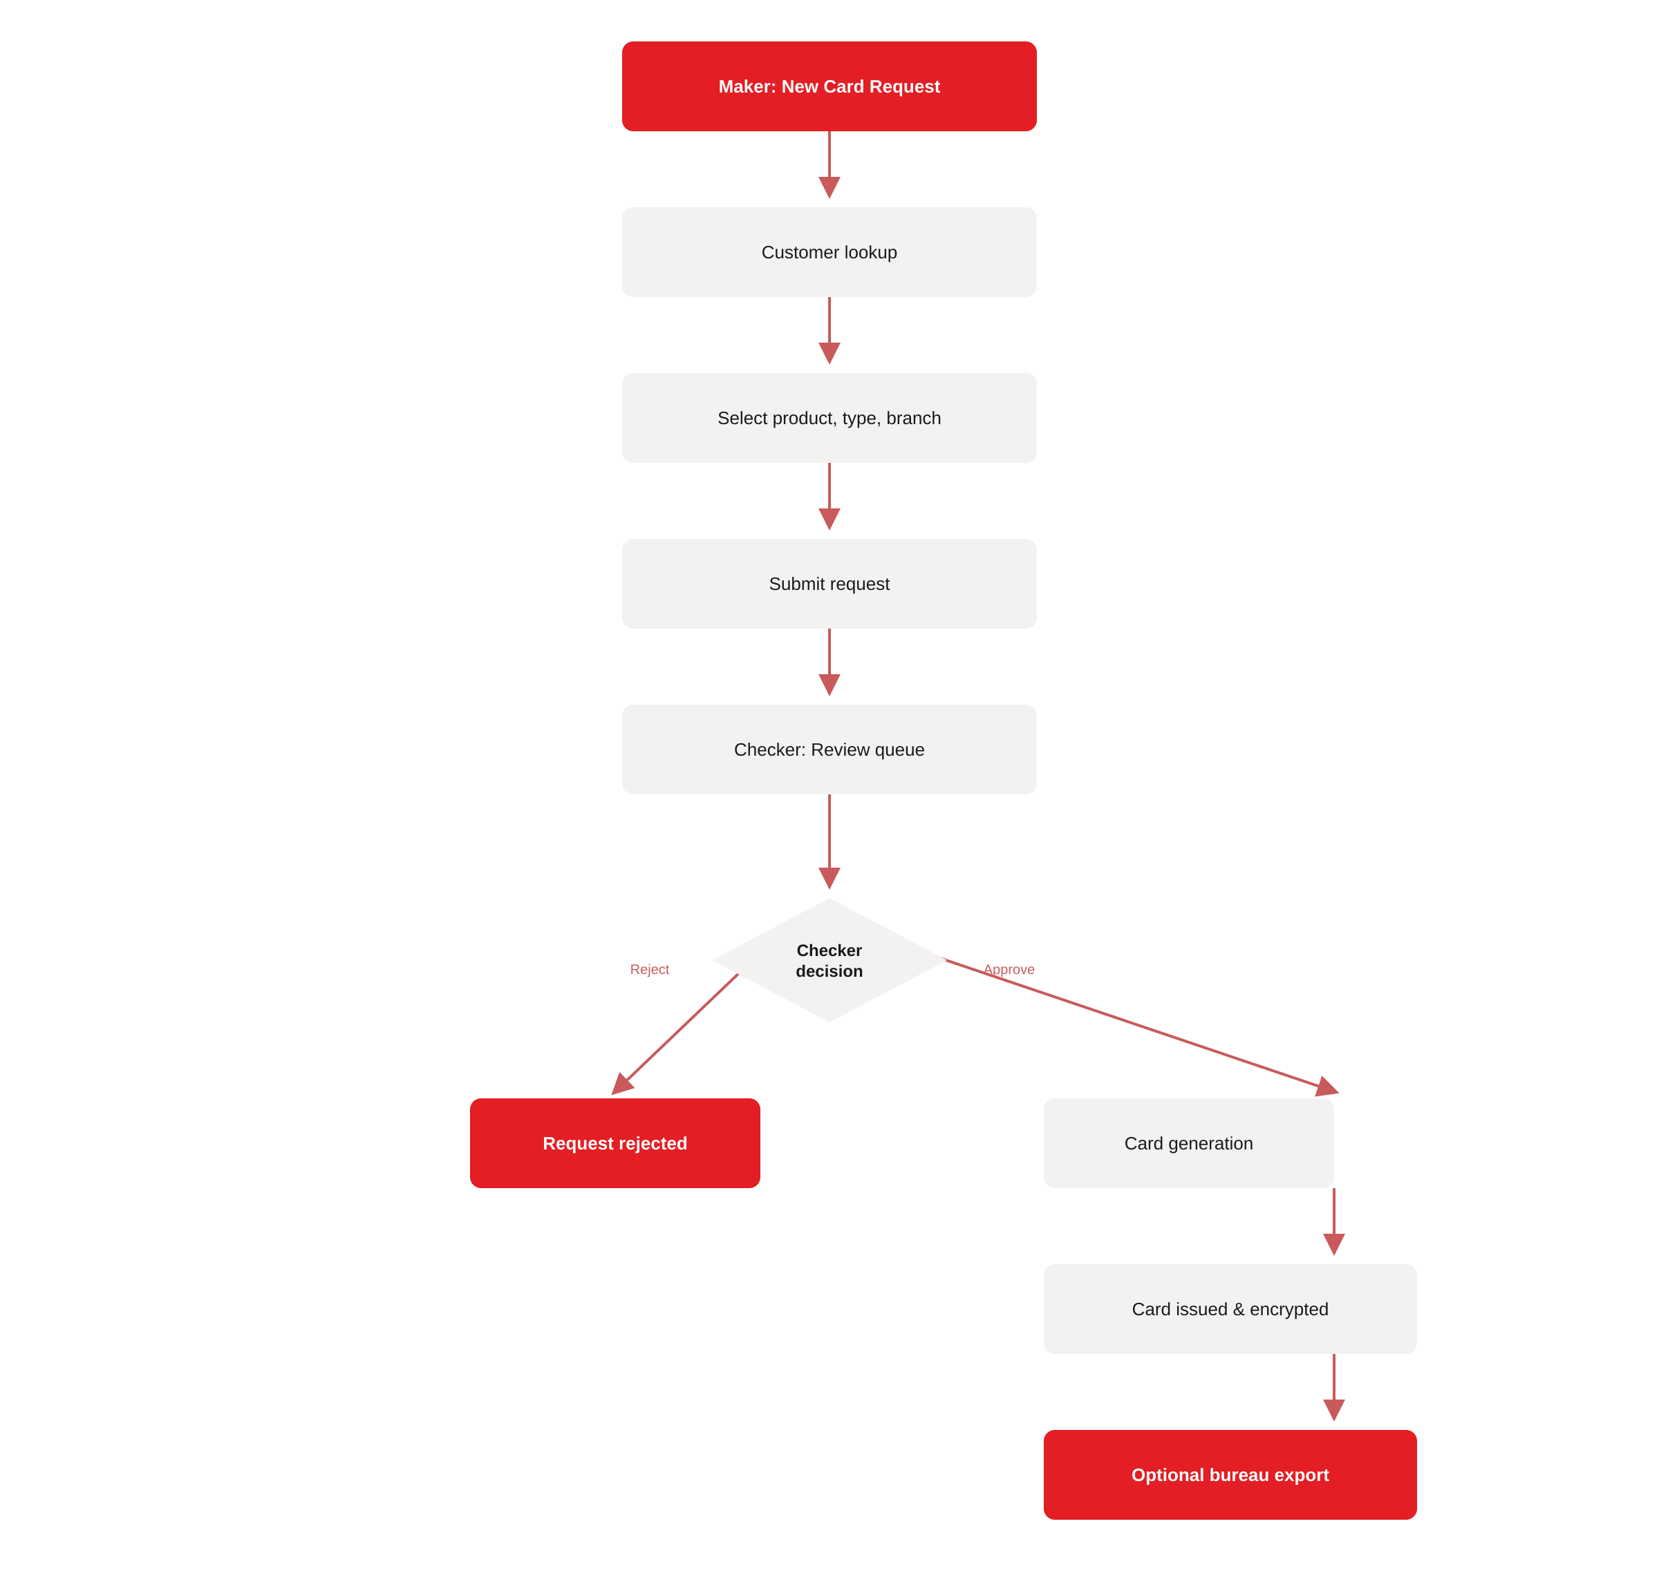
CARD LIFECYCLE
The Card Lifecycle at a Glance
A maker submits a new card request against a customer account
An independent checker approves or rejects the request
On approval, the card is generated and the PAN is encrypted
Issued cards can optionally be exported to the card bureau
LasPay Card Management System | Confidential
6 / 27
Notes:
This is the flagship flow and the one to remember: request, approve, generate, issue. Every new card in LasPay CMS goes through this exact sequence — there is no path that skips the checker approval step. If a request is rejected, it stops here with a full audit record. If approved, the card is generated, the card number is encrypted at rest, and — where required — the card is queued for export to our card bureau for physical production. We'll walk through each of these steps on real screens, with their underlying APIs, over the next several slides.

Slide 7
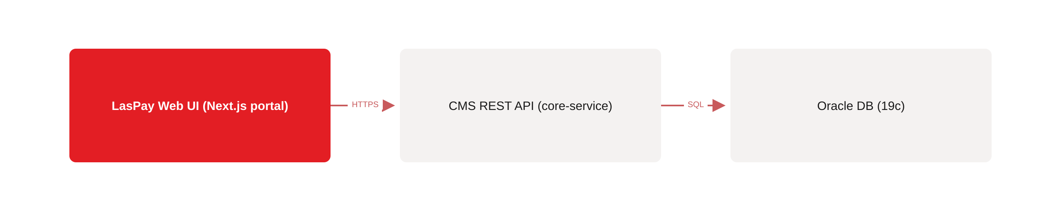
HOW IT'S BUILT
Simple, Secure Architecture
A web portal — no client software to install or maintain
A secured API layer (core-service) that enforces every business rule
An Oracle database — enterprise-grade, encrypted card data at rest
Example: portal calls POST /api/auth/login, then GET /api/dashboard/summary
LasPay Card Management System | Confidential
7 / 27
Notes:
I'll keep this to one slide because the architecture detail belongs with our technical teams, not here. The important business takeaway is that it's a standard three-tier design: a browser-based portal, a secured REST API — core-service — that enforces every rule we're about to discuss, like dual control, and an Oracle database where card data is encrypted at rest. Every screen in this deck calls a small set of these APIs, which we'll point out flow by flow; the full endpoint catalogue lives in Appendix A of the business guide and in Swagger, not in this room.

Slide 8
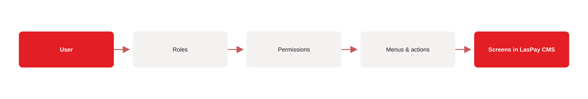
SECURITY & CONTROL
Security Model: Dual Control & Role-Based Access
Dual control — a maker can never approve their own request
Role-based access — users see only the menus their role permits
PAN protection — card numbers are always shown masked in the UI
Full audit trail on every administrative and card action
LasPay Card Management System | Confidential
8 / 27
Notes:
This is the slide I'd ask you to remember above all others. Dual control is enforced in the system itself, not just in a written policy — the platform will not let a maker approve their own request. Access is role-based, so a card operator simply cannot see the housekeeping or security screens, and vice versa. Card numbers are masked everywhere in the interface, and every meaningful action — approvals, rejections, status changes, configuration changes — is logged for audit.

Slide 9
SECURITY & CONTROL
Who Does What: User Roles
Administrator — full access to users, roles, permissions, and all modules
Maker — creates and edits new card requests
Checker — approves or rejects pending card requests
Card Operator / Viewer — day-to-day operations, or read-only reporting access
LasPay Card Management System | Confidential
9 / 27
Notes:
Five roles cover the full user population. Administrators are typically IT or system administration. Makers and Checkers are the two halves of dual control — usually branch operations staff and a supervisor respectively, and critically, never the same person for the same request. Card Operators handle search, status changes, and replacements day to day, and Card Viewers get read-only access for reporting or oversight without any ability to change data.

Slide 10
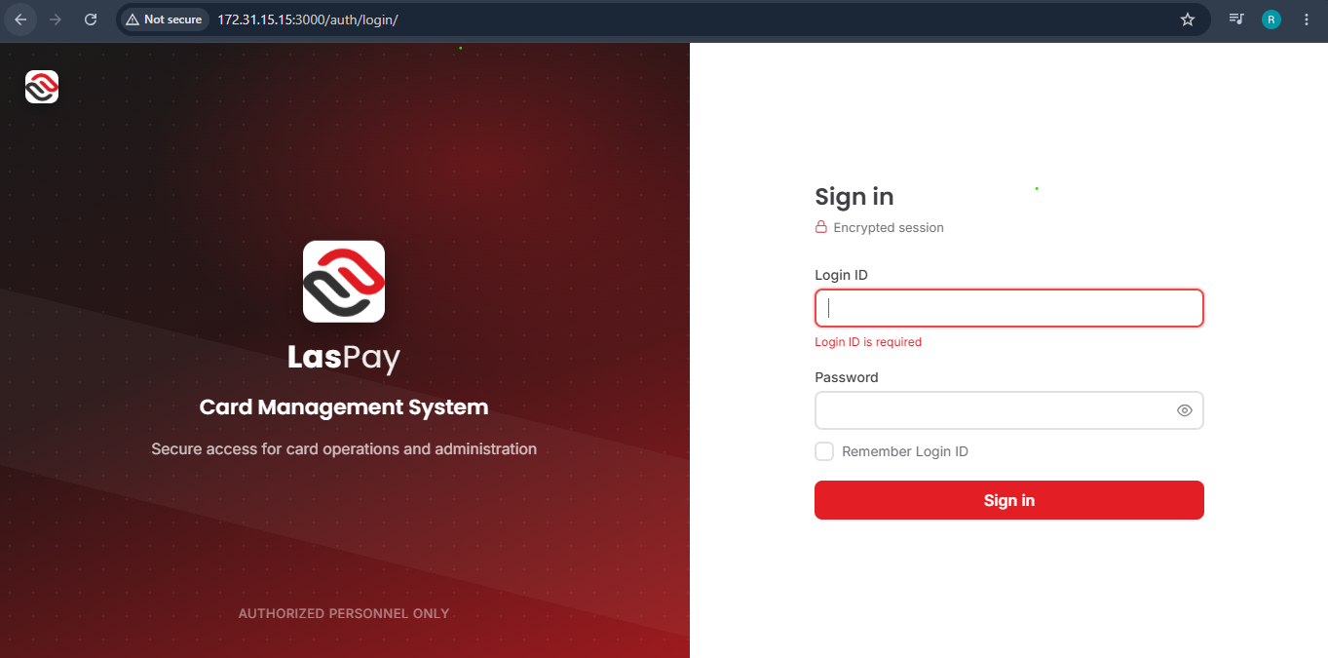
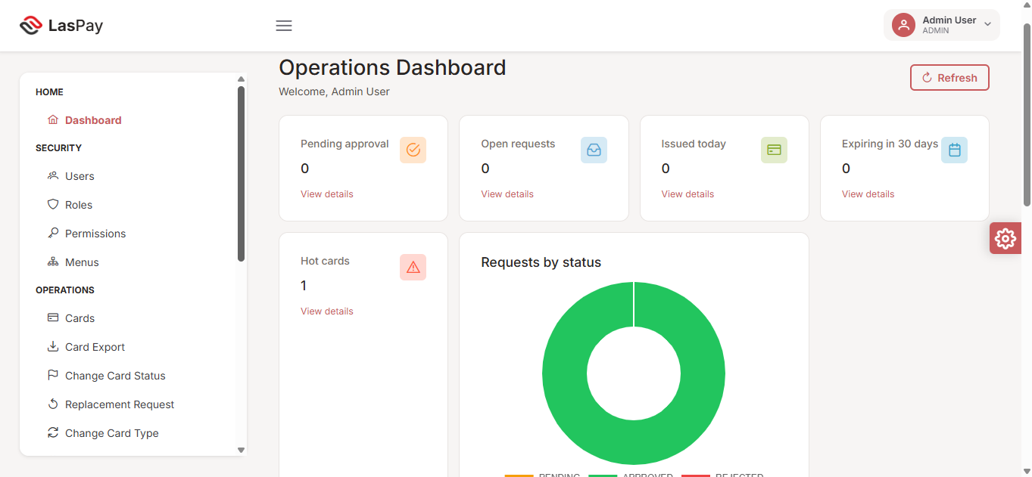
FLOW 5.1
Sign in & Dashboard
Purpose: Give every user a real-time view of operational KPIs and quick access to their work.
Authorised sign-in with a session-based login
Pending approvals, open requests, and cards issued today — all at a glance
Expiring-soon and “hot” (flagged) cards surfaced automatically
Refreshes on load; leadership can check status anytime
APIs
POST /api/auth/login — Authenticate user
GET /api/dashboard/summary — Dashboard KPIs and queues
GET /api/my-menus — Build navigation for current user
LasPay Card Management System | Confidential
10 / 27
Notes:
This is where every session starts. A user signs in — authenticated by the login API you see listed — and lands straight on the dashboard, built from the dashboard-summary and menu APIs. For management, this dashboard is the single most useful screen in the system: pending approvals, requests in flight, cards issued today, and anything flagged as high-risk, all in one view, backed by two lightweight API calls.

Slide 11
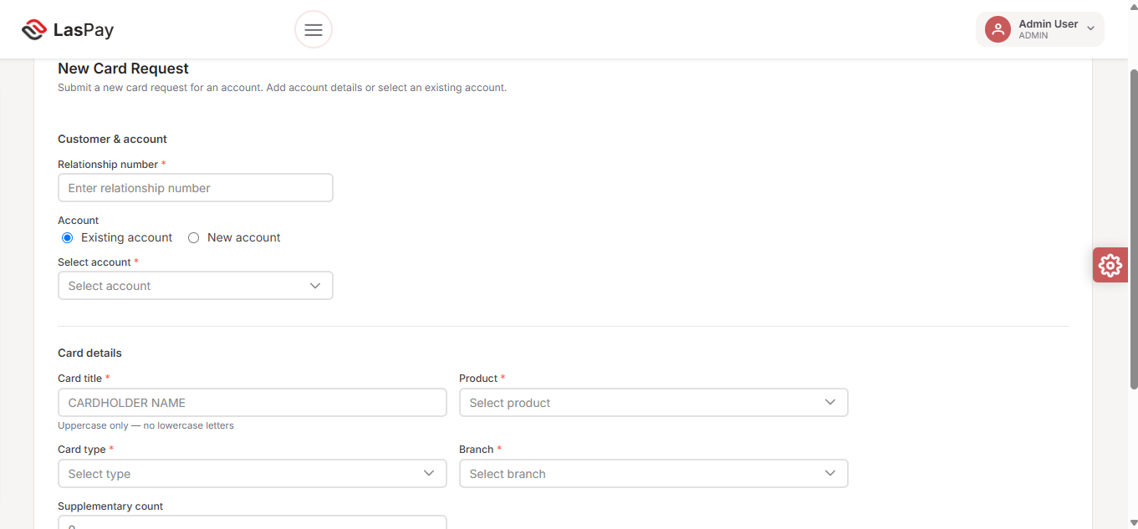
FLOW 5.2
New Card Request (Maker)
Purpose: Allow a maker to submit a new card request for an existing or new customer account.
Maker enters the customer's relationship number to load the account
Card details captured: title, product, type, branch
Card title enforced uppercase; all mandatory fields validated
Submission moves the request into the checker's queue — nothing is issued yet
APIs
GET /api/card-requests/customer-info — Load customer and accounts
POST /api/card-requests — Submit new card request
PUT /api/card-requests/{id} — Edit before approval
GET /api/products — Product dropdown
GET /api/card-types — Card type dropdown
GET /api/branches — Branch dropdown
LasPay Card Management System | Confidential
11 / 27
Notes:
This is where the lifecycle begins. A maker looks up the customer by relationship number — that's the customer-info API — completes the card details using the product, type, and branch dropdowns, and submits. Submitting only creates a pending request; nothing is issued until an independent checker reviews and approves it, which is our next slide.

Slide 12
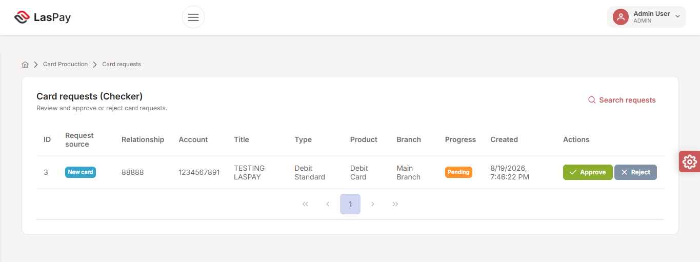
FLOW 5.3
Approval Workflow — Dual Control in Action
Purpose: An authorised checker reviews pending card requests and approves or rejects them.
Checker reviews relationship, account, title, type, and product details
One click to Approve or Reject, with a mandatory audit record either way
The system enforces that the maker cannot also be the checker
Rejected requests stay fully searchable for audit
APIs
GET /api/card-requests/checker — Checker queue
GET /api/card-requests/maker — Maker queue
POST /api/card-requests/reject — Reject with reason
POST /api/card-generation/request/{id}/approve-and-generate — Approve and generate
GET /api/card-requests/search — Search historical requests
LasPay Card Management System | Confidential
12 / 27
Notes:
Here is dual control in practice. The checker — a different person from the maker, enforced by the system itself — pulls the checker queue, reviews the request, and either approves it, which calls straight through to card generation, or rejects it with a reason, which stops the process entirely and creates a permanent audit record.

Slide 13
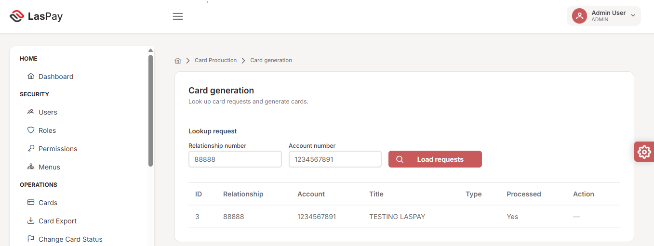
FLOW 5.4
Card Generation
Purpose: Generate the card record after checker approval — the final step before a card is issued.
Only checker-approved requests are eligible for generation
Card record created and the card number (PAN) is encrypted
Optional automatic export to the card bureau for physical production
Processed flag confirms completion; no duplicate generation possible
APIs
POST /api/card-generation/request-by-code — Find requests by relationship & account
POST /api/card-generation/request/{id}/approve-and-generate — Generate from approved request
POST /api/card-generation/process — Process generation
PUT /api/card-generation/request/{id}/progress — Update workflow progress
LasPay Card Management System | Confidential
13 / 27
Notes:
Once approved, an operator loads the approved request — the request-by-code API — and processes generation. The card record is created, the PAN is encrypted immediately, and the progress API marks it processed so the same request can never be generated twice.

Slide 14
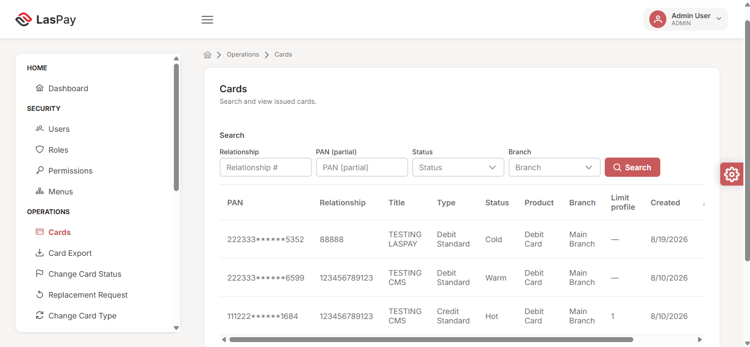
FLOW 5.5
Card Search & Day-to-Day Operations
Purpose: Give operators one consistent way to find and act on any card across the full book.
One unified search screen powers every operational task that follows
Search by PAN, relationship number, card type, or date range
Same search experience reused for status changes, replacement, and export
Full card detail available in a single call once a card is found
No screenshot available in
source material for this screen.
APIs
POST /api/cards/search — Filter cards by criteria
GET /api/cards/{id} — Full card detail
GET /api/cards/dropdowns — Filter options (types, statuses)
GET /api/cards/customer-by-relation — Customer info by relationship #
LasPay Card Management System | Confidential
14 / 27
Notes:
Before we look at the individual operational actions, it's worth noting they all share one search experience and one small family of APIs. Whether an operator is changing a card's status, requesting a replacement, or preparing a bureau export, they get to the card the same way — a familiar, consistent search screen backed by the cards/search API. Note for the room: our source screenshots don't include a dedicated card-search capture, so this slide runs on the API and business detail alone.

Slide 15
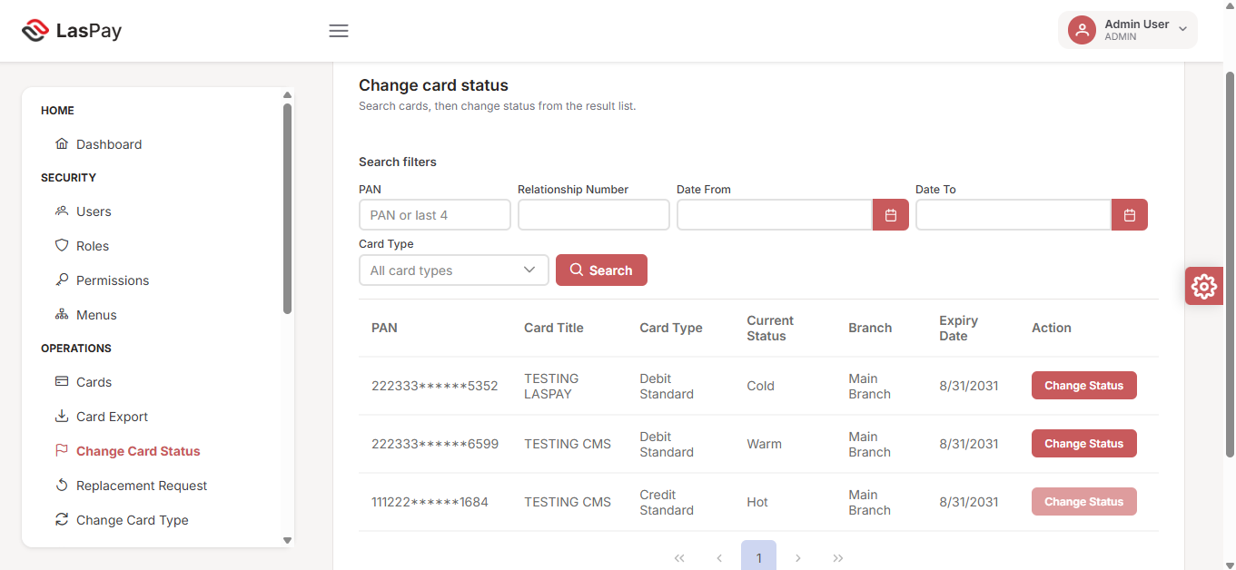
FLOW 5.6
Change Card Status
Purpose: Update a card's operational status — for example Cold to Warm to Hot — for risk handling.
Operator searches, selects a card, and applies the new status
Status values themselves are configured centrally in housekeeping
“Hot” cards are automatically flagged on the dashboard
Every status change is logged for audit
APIs
POST /api/cards/search — Find target card
PUT /api/cards/{id} — Apply new card status
LasPay Card Management System | Confidential
15 / 27
Notes:
Status changes are how we manage card risk day to day — for example flagging a card as 'Hot' if fraud is suspected. Just two APIs power this entire flow: search to find the card, and a single update call to apply the new status. That flag immediately surfaces on the dashboard we saw earlier, so risk and operations leadership see it in real time.

Slide 16
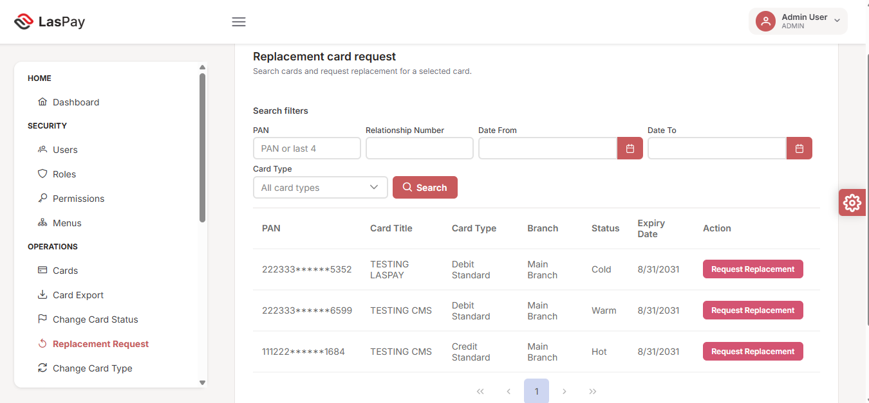
FLOW 5.7
Replacement Request
Purpose: Initiate a replacement card when the existing card is lost, damaged, or compromised.
Operator locates the existing card and requests a replacement
Replacement re-enters the same controlled production pipeline
Original card is superseded once the replacement is generated
Full history retained against the customer's account
APIs
POST /api/cards/search — Find target card
POST /api/cards/{id}/replacement-request — Create replacement request
LasPay Card Management System | Confidential
16 / 27
Notes:
Replacement follows the same production discipline as a brand-new card — it doesn't bypass any of the controls we've already discussed. The replacement-request API marks the original inactive and creates a new request that flows straight back through approval and generation, so even a routine replacement is fully traceable.

Slide 17
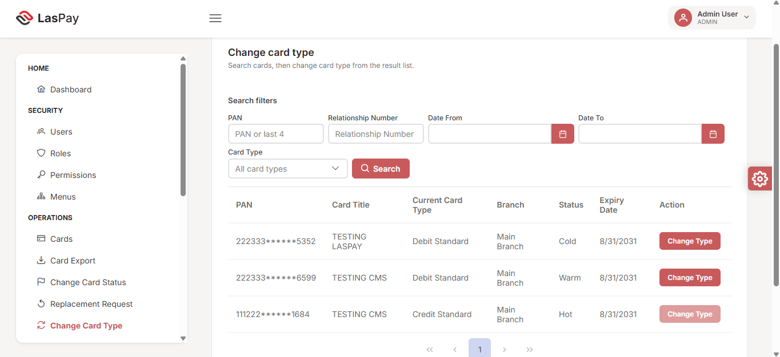
FLOW 5.8
Change Card Type
Purpose: Change an existing card from one type to another, for example Standard to Premium.
Operator selects the card and the target card type
Card type must be Active in housekeeping to be selectable
Limits and features update to match the new type automatically
Change is reflected immediately in operations and reporting
APIs
POST /api/cards/search — Find target card
POST /api/cards/{id}/change-card-type — Change card type
LasPay Card Management System | Confidential
17 / 27
Notes:
This gives us a controlled path for product upgrades or downgrades — for instance moving a customer from a standard card to a premium product — without having to close and reissue a completely new card. Again, just two APIs: find the card, then submit the type-change request.

Slide 18
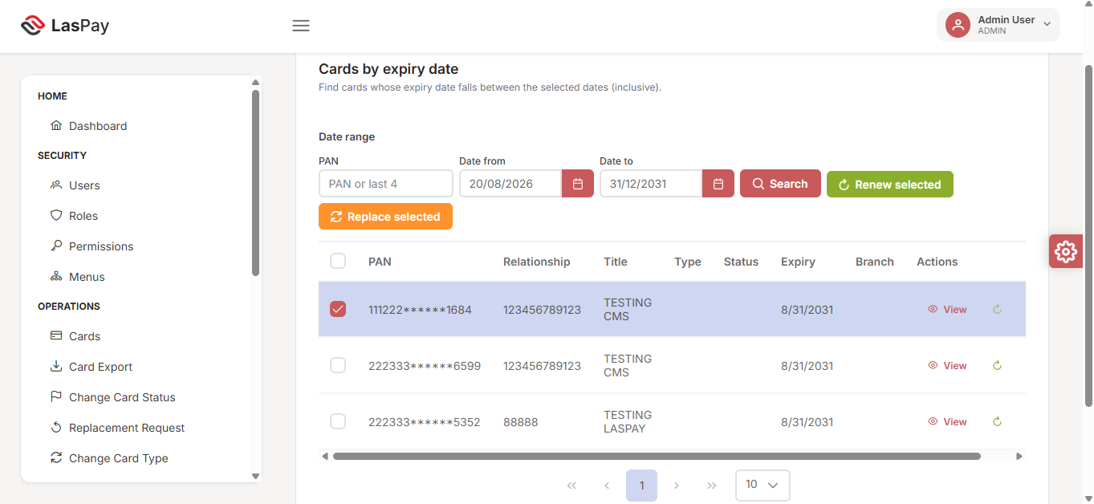
FLOW 5.9
Cards by Expiry Date
Purpose: Identify cards approaching expiry and perform bulk renewal or replacement.
Search any date range to see cards expiring in that window
Select multiple cards and renew or replace in bulk
Reduces manual, one-by-one processing at scale
Individual card detail still available via View
APIs
POST /api/cards/expiry-search — Find cards in date range
POST /api/cards/bulk-renew — Extend expiry on selected cards
POST /api/cards/{id}/replacement-request — Replace selected cards
LasPay Card Management System | Confidential
18 / 27
Notes:
This is one of the more operationally valuable screens for a large card book. The expiry-search and bulk-renew APIs mean an operator can pull every card expiring in the next 30 or 60 days and action them in bulk, rather than processing renewals one at a time — a direct efficiency gain as our card base grows.

Slide 19
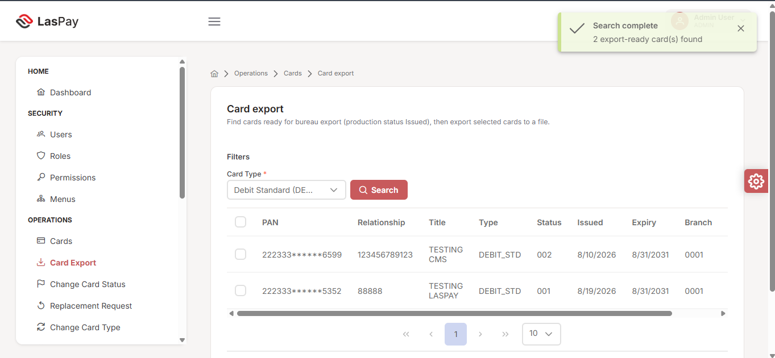
FLOW 5.10
Card Export to Bureau
Purpose: Export issued cards that are ready for physical card bureau production.
Only cards with status Issued are eligible for export
Requires the dedicated export permission — access is restricted
Export file generated to a secured output location
Closes the loop from digital issuance to physical card production
APIs
POST /api/cards/export-ready — List export-ready cards
POST /api/cards/bulk-export — Generate bureau export file
GET /api/cards/{id}/export-file — Download export file
LasPay Card Management System | Confidential
19 / 27
Notes:
This is the handoff point to our physical card production partner. Only issued cards are eligible, and only users with explicit export permission can trigger it — export-ready lists the candidates, bulk-export generates the file, and export-file lets an authorised user download it.

Slide 20
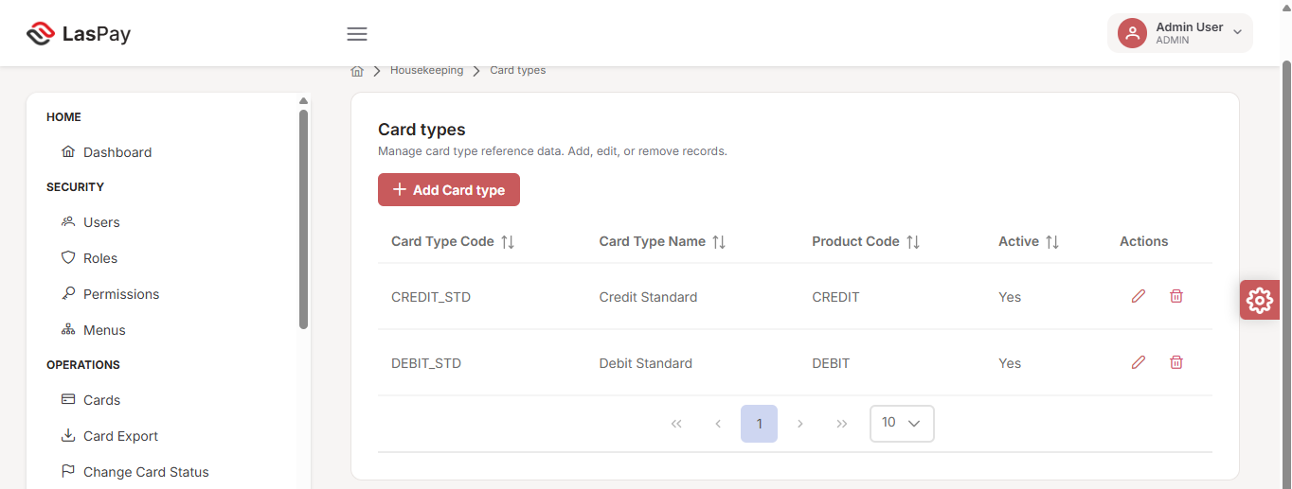
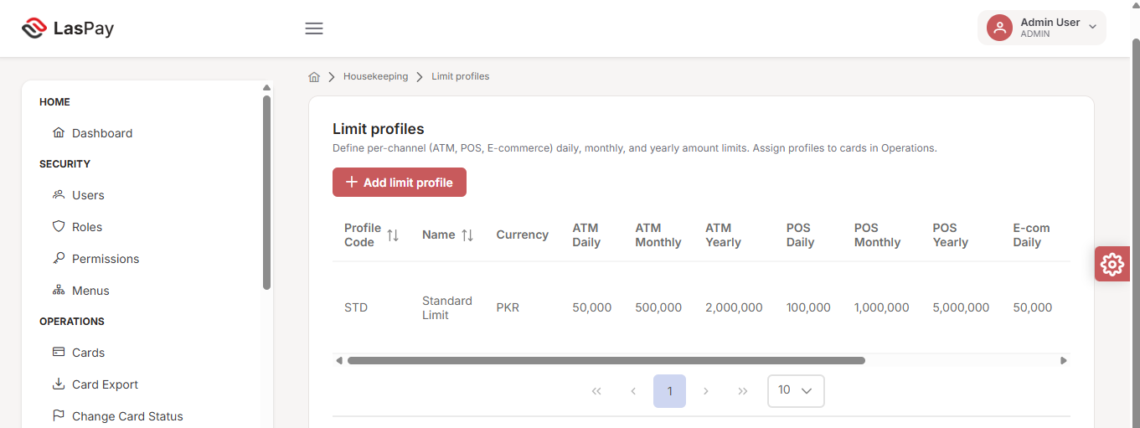
FLOW 5.11
Master Data Setup (Housekeeping)
Purpose: Configure the reference data that card production and operations depend on.
Branches, products, card types, and limit profiles — all centrally managed
Products and card types must be Active to appear in card requests
Limit profiles define per-channel caps (ATM, POS, e-commerce) in PKR
Administrator-only — keeps reference data governed, not hard-coded
APIs
CRUD /api/branches — Branches
CRUD /api/products — Products
CRUD /api/card-types — Card types
CRUD /api/limit-profiles — Limit profiles
LasPay Card Management System | Confidential
20 / 27
Notes:
This is the configuration backbone behind everything we've seen so far. Branches, products, card types, and limit profiles are each their own small CRUD API and their own screen, all administrator-only — so when the business wants to launch a new card product or adjust a spending limit, it's a controlled configuration change, not a code change. Products screen is captured in the business guide too; showing card types and limit profiles here as the two most frequently touched by the business.

Slide 21
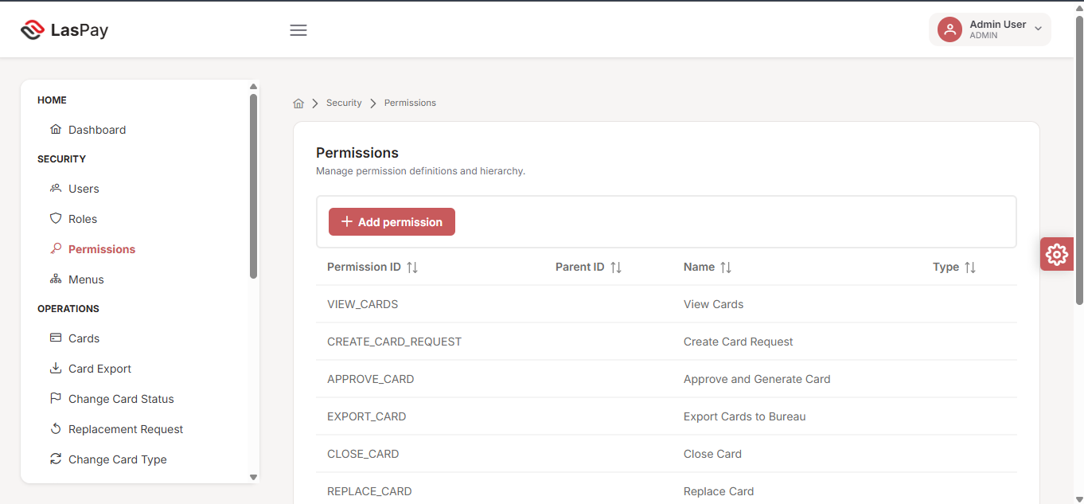
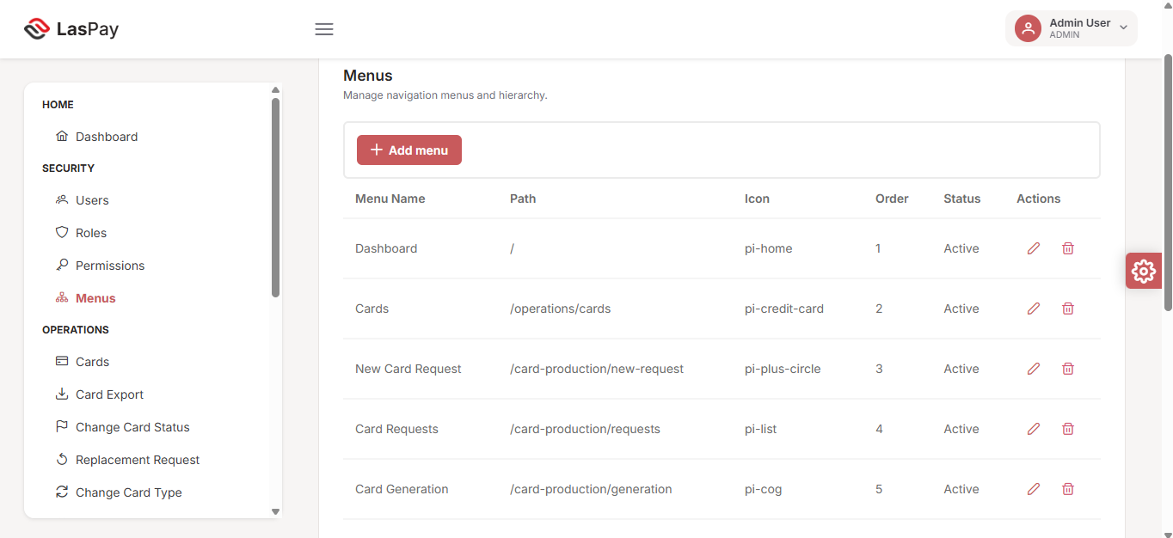
FLOW 5.12
Security & Access Control
Purpose: Manage who can access LasPay CMS and exactly what actions they can perform.
Users, Roles, Permissions, and Menus configured centrally
Every user needs at least one active role to sign in
Menu visibility is driven directly by each user's role
Permission checks are enforced on every protected action, not just the menu
APIs
CRUD /api/users — User management
CRUD /api/roles — Roles
CRUD /api/permissions — Permissions
CRUD /api/menus — Menu configuration
POST /api/users/{id}/roles — Assign roles to user
LasPay Card Management System | Confidential
21 / 27
Notes:
This is where administrators define and maintain the role-based access model we introduced earlier — users, roles, permissions, and menus each have their own CRUD API, plus a dedicated call to assign roles to a user. It's worth emphasising: permission checks happen on the action itself, at the API level, so even if someone reached a screen they shouldn't, the underlying action would still be blocked. We're showing permissions and menu configuration here; user and role management follow the same pattern.

Slide 22
REFERENCE
One Platform, Five Modules, Full Coverage
Home — the operational dashboard
Security — users, roles, permissions, menus
Operations — search, status, replacement, type change, export
Card Production & Housekeeping — request, approve, generate, configure
LasPay Card Management System | Confidential
22 / 27
Notes:
This is a quick recap of everything we've just walked through, organised by the five modules we opened with. Every screen — and every API — we saw maps back to one of these areas. The full module and API reference lives in the business guide appendices for our QA and business teams.

Slide 23
TECHNICAL INTEGRATION
REST API Layer: The Short Version
core-service REST API, every endpoint under /api/, secured with JWT Bearer authentication
Each flow slide in this deck already lists its key APIs alongside the screen
Full endpoint contracts and live testing: Swagger UI at /swagger-ui.html
Complete API reference for engineering and integration: Business Guide Appendix A
LasPay Card Management System | Confidential
23 / 27
Notes:
One deliberate note on the technical side: the platform runs a single REST API layer, core-service, with every endpoint under /api/ and secured with a JWT Bearer token. Rather than a separate technical appendix, we've put each flow's key APIs directly on its slide throughout this deck, so you've already seen most of what matters. For engineering and integration partners, the full endpoint contracts — request and response schemas — live in Swagger and in Appendix A of the business guide; we won't walk through those line by line here.

Slide 24
VALUE RECAP
Why This Matters to the Business
Reduces operational risk through system-enforced dual control
Cuts manual, spreadsheet-driven processes across the full card lifecycle
Gives leadership real-time visibility via the dashboard, not periodic reports
Centralised configuration lets the business launch products faster
LasPay Card Management System | Confidential
24 / 27
Notes:
Bringing it back to the business case: this system reduces risk because dual control is enforced by software, not just policy. It removes manual, error-prone processes. It gives leadership a live view instead of waiting for a weekly report. And because product and limit configuration is centralised, launching a new card product is a configuration change, not a development project.

Slide 25
COMPLIANCE
Security & Compliance Summary
Dual control on every card request — no exceptions
PAN always masked; encrypted at rest and in transit
Role-based access enforced at both the screen and the API level
Full audit trail supports internal and regulatory review
LasPay Card Management System | Confidential
25 / 27
Notes:
This is the slide for our risk and compliance stakeholders specifically. Dual control has no bypass. Card numbers are masked in every view and encrypted at rest. Access control is enforced twice — once at the screen level and again at the API level — and every meaningful action leaves an audit record. This is designed to hold up under regulatory review.

Slide 26
NEXT STEPS
Roadmap & Next Steps
Complete UAT sign-off with business and QA stakeholders
Finalise role and permission mapping for go-live users
Schedule operator training on the screens covered today
Agree go-live date and post-launch support model
LasPay Card Management System | Confidential
26 / 27
Notes:
Looking ahead: we need business and QA sign-off on UAT, final confirmation of who gets which role at go-live, a short training session for operators on exactly the screens we walked through today, and agreement on the go-live date and how support will work in the first few weeks. We can align on owners and dates for each of these right after this session.

Slide 27
Thank You
Questions & Discussion
LasPay Card Management System | Karsaaz — CMS Delivery Team
Notes:
That covers the business walkthrough — the platform's structure, the full card lifecycle with dual control at its core, the dashboard KPIs, the APIs behind each screen, and the security and compliance posture. I'll open it up for questions now, and happy to go deeper on any specific flow, API, or roadmap item afterward.

